Slide 1
Biomarkers discovery for detection of early breast cancer
Summaya Anwar
Lanaka Gaston
Raneen Hoballah
Nassoufi chaimaa
Misbah ilyas
Rayapu Charan Tej
Fatma Ragab Abd Elhaseeb
Haya Nahhas

Slide 2
Introduction
Breast carcinomas arise through coordinated changes in gene expression as normal epithelium acquires malignant features. Public paired datasets allow within-patient tumor–normal contrasts, reducing inter-individual noise and sharpening disease signals. Using GSE15852 (Affymetrix HG-U133A; 43 tumors with matched adjacent normals), we will define the core expression shifts that mark malignant transformation and link these shifts to biological pathways from which biomarker candidates can be nominated.

Slide 3
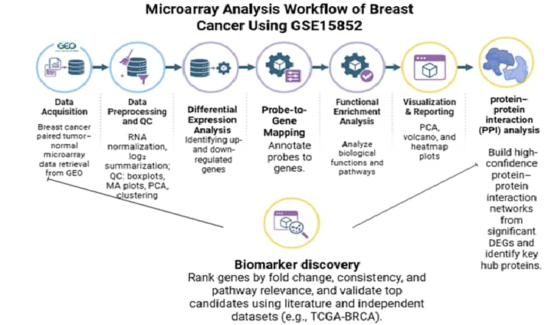
Methodology
Validation with ML
Validate the predictive capability of the nominated biomarker candidates to distinguish tumor from normal samples by training and optimizing supervised classification models (Random Forest and SVM) and evaluating their generalization performance on an independent test set using AUC as the primary metric.

Slide 4
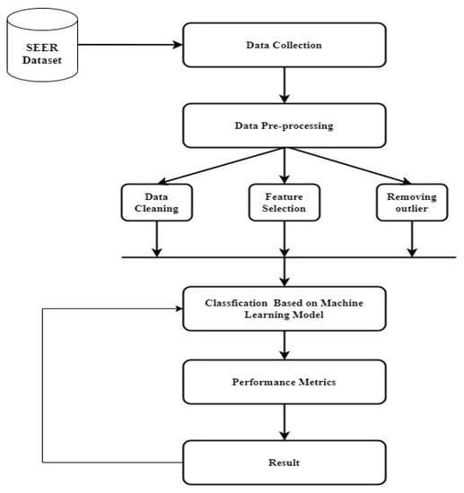
Supervised Learning Methodology

Slide 5
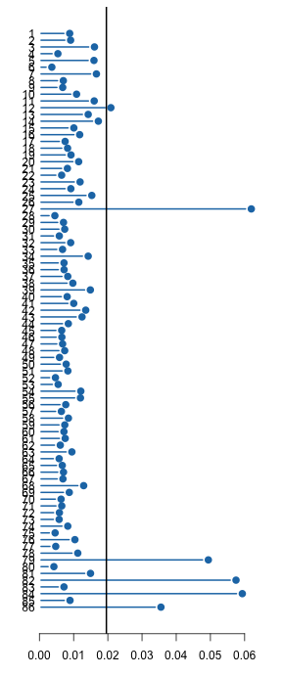
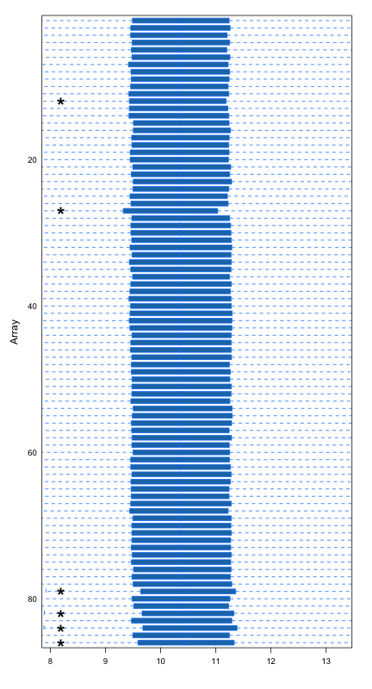
Results and Intepretation
Outlier Summary and Normalization:
The plot, generated by the arrayQualityMetrics package, serves as an outlier summary by measuring the distance of each sample's overall expression distribution (Box Plot) from the median distribution of the entire dataset. The vast majority of the 86 samples fall to the left of the black vertical threshold line (at approx 0.02), confirming that the RMA normalization was highly successful and the data is consistent across most samples. However, there are five prominent samples—27, 79, 83, 85, and 86—that fall significantly to the right of this threshold, indicating they possess expression distributions that are highly dissimilar to the norm, flagging them as potential outliers that should be investigated further or considered for removal prior to differential expression analysis.

Slide 6
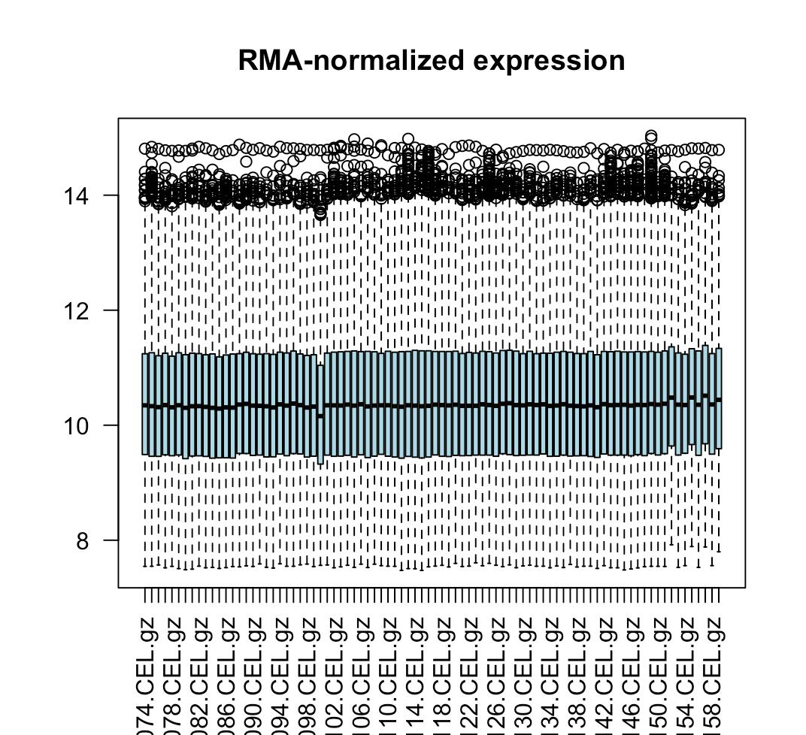
Box Plot of the RMA-normalized expression data:
This box plot confirms the successful application of Robust Multi-array Average (RMA) normalization to the dataset. Following normalization, the core distributions of gene expression values for all samples, represented by the light blue boxes, are highly aligned and consistent. Specifically, the medians (thick black lines) are precisely positioned around a (log_2) expression value of 10-10.5, and the Interquartile Range (IQR)—the height of the box—is uniform across all arrays. This uniformity signifies that the technical variability between arrays has been effectively removed, making the gene expression levels comparable across all samples and thus preparing the data for robust differential expression analysis. The presence and pattern of individual outliers (small circles) are consistent across arrays and do not suggest any single array has a major quality issue.

Slide 7
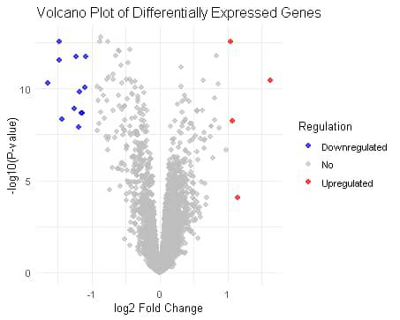
Differential Gene Expression
Volcano Plot:

Slide 8
DEG Results
Total DEGs identified: 16 genes
Upregulated in tumors: 4 genes (mean log2FC = 2.45)
Downregulated in tumors: 12 genes (mean log2FC = -2.34)
Top DEG: CD24 (log2FC = 3.94, p.adj = 1.2e-15

